Slide 1
Bunker Gear and SCBA Safety
Minimum Requirements Training
4/6/2014

Slide 2
Introduction
This training is to cover the minimum competency standards necessary for entering a structure fire with the Priceville Volunteer Fire Department.
Upon completion of this training one will be required to complete a written exam with a score of 80% or greater, and will demonstrate being able to put on your bunker gear and SCBA within 2 minutes.
We want you to feel comfortable, competent, and safe while wearing your Personal Protective Equipment.

Slide 3
The SCBA
We use a Dräger brand Self Contained Breathing Apparatus (SCBA for short)
The SCBA is used to provide respiratory protection from smoke, heated gases, and various chemicals which are put airborne from toxic environments and fires.

Slide 4
Dräger SCBA
4500 psi, 30 minute cylinders
MMR now comes over the right shoulder
Pressure gauge and PASS device now on the left shoulder
Computerized air monitoring with digital pressure feedback.
Computer has “black box” capabilities.

Slide 5
Harness
Padded harness articulates around hips.
Computer and batteries built into harness
Harness height is adjustable
Hole a carabiner can fit into if necessary. Holds 500 lbs

Slide 6
Harness- Right Side
MMR comes over the right shoulder

Slide 7
Harness- Left Side
Buddy-breather line next to left hip
Pressure gauge is on the left side as well

Slide 8
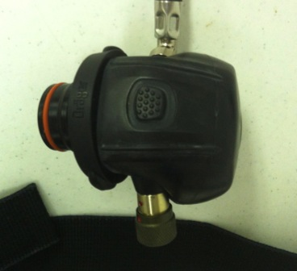
The Mask Mounted Regulator (MMR)
-Button top turns off regulator
-Emergency Bypass is on right side of regulator
-You can push in Emergency Bypass for quick pulses of air -OR- turn it for continuous air
-Verify regulator is locked in place by trying to pull it away from mask.
-Buttons are on each side to release MMR

Slide 9
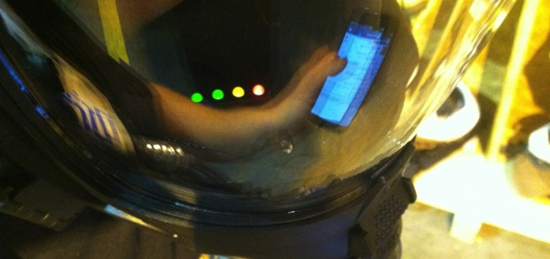
Mask
-Green light indicates voice amplifier is on. Voice amp turns off on its own after no usage
-Head’s Up Display shows level in cylinder.
-There is a blue light that indicates when the mask sync’s with the computer on the SCBA
-Lights stay on 12 sec/min

Slide 10
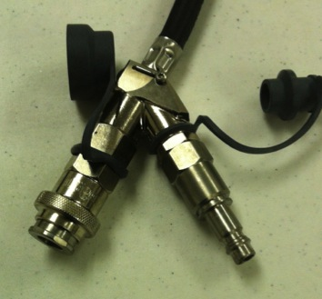
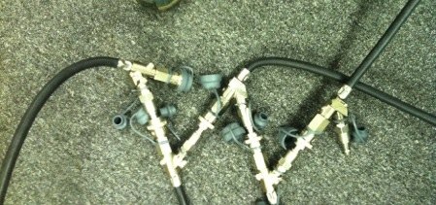
Buddy Breather
-Can connect a partner’s regulator into this
-Can plug multiple buddy breathers together
-Uses the air from the SCBA with highest pressure

Slide 11
Cylinder Valve & Universal Air Connection
Valve and UAC are both by the wearer’s right hip
You do not have to push knob to turn off valve.
Ensure you open the valve fully.
The UAC connects to a RIT/RIC pack from ALL manufacturers. It DOES NOT connect to your buddy breather.

Slide 12
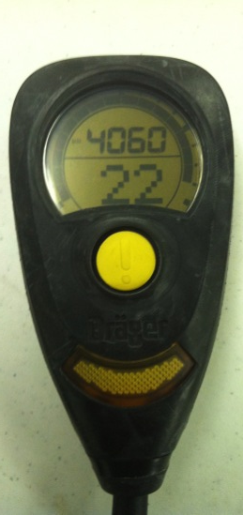
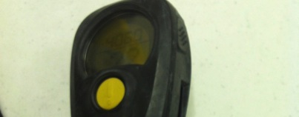
Pressure Gauge & PASS Device
-The PASS device turns on when you turn on the air
-Pressure is displayed on top
-The “22” shows how much air you have left until you reach the end of service time (1/4 tank) at the rate you are breathing. The PASS quickly chirps when you reach ½ and ¼. The alarm continuously sounds when pressure gets low.
-The PASS device is integrated within the pressure gauge. The motion sensor is located within..
-The two buttons to silence the PASS device are on the sides. These buttons also turn off PASS when pressure is 0 psi

Slide 13
PASS Device
The Personal Alert Safety System, PASS device for short, is a device worn by a firefighter used to signal others for help.
After the air is turned on, the PASS device is actuated:
1-Manually: by pushing the button on the front of the device
2-No motion over time: If a firefighter remains motionless for 20-30 seconds.
3-Impact: if a firefighter falls or tumbles it will actuate
4-Temperature: if you are in a really hot environment the device will sound.
If you watched videos from the World Trade Center collapse many of these devices could be heard in the background. An activated PASS device could mean one of your teammates is in trouble. Always keep your ears open and be ready to send in a RIT Team if you hear this from inside of a structure.

Slide 14
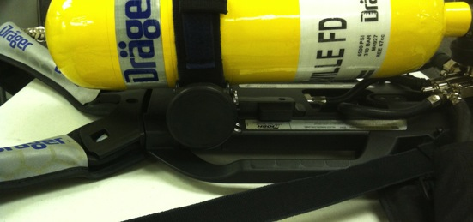
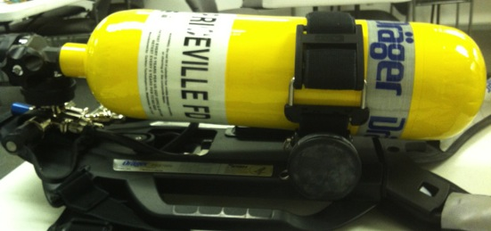
PASS Device is Actuated 360 Degree Sound
-Sound comes out a few places

Slide 15
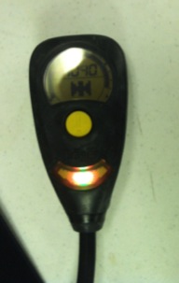
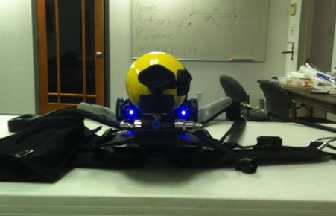
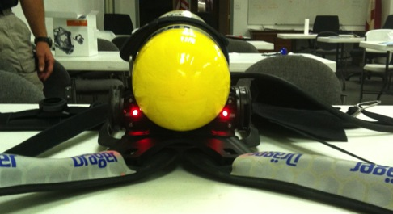
PASS Device is Actuated Lights
-Blue Suede Shoes
-Red at the head

Slide 16
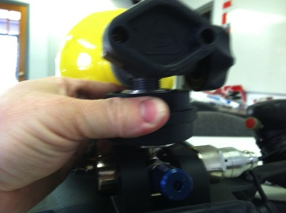
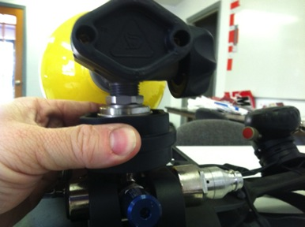
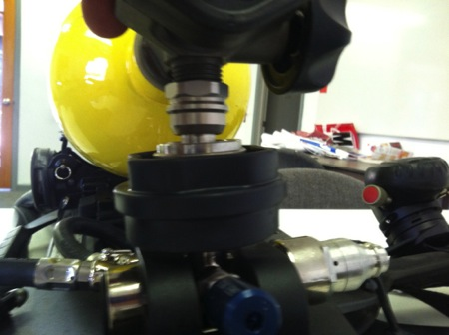
Removing Cylinder
-Turn the cylinder off
-Loosen the cylinder strap
-Rotate the black collar clockwise
-Pull the black collar down away from cylinder
-The cylinder will pop free and come out

Slide 17
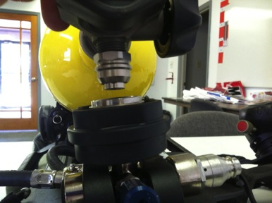
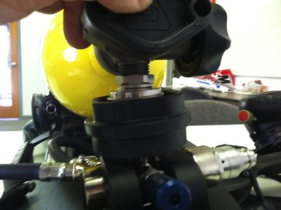
Replacing Cylinder
-Push the cylinder down until it clicks in the socket
-Tighten the cylinder strap
-Turn air on to keep breathing

Slide 18
Donning the SCBA- Part 1
Let’s go over a way to put on the SCBA.
Start with the SCBA in front of you with all straps on your mask and harness fully extended (mind you, when you take off the SCBA you should be extending the straps)
Verify your straps are not entangled with the regulator, pressure gauge/PASS device, and so forth…
A quick inspection to ensure no damage to the SCBA. If there is damage, take the SCBA out of service and do not use.

Slide 19
Donning the SCBA- Part 2
Verify the air pressure of your cylinder gauge. It will need to be within 100 psi of your chest gauge (or resembles the indication in your HUD) when you turn the air on. Leave your cylinder off for now.
Put the SCBA on your back like a backpack, right arm first (basis to be explained in a future lecture). Be careful not to sling your regulator and PASS device into surrounding people or equipment. You may damage them as a result.

Slide 20
Donning the SCBA- Part 3
While leaning forward grab and pull the shoulder straps straight down. Put the SCBA into a position of comfort on your back.
Connect the buckle for the waist straps. Pull the loose ends of the straps and tighten it to your waist. You should be able to breathe and have a good range of motion.
Place your chin into the bottom of the mask and pull the webbing/straps of the mask over your head. Tighten the mask to your head by pulling the straps towards your back starting with the jaw straps, then temple straps, then finally top strap. Webbing of strap should be positioned in the middle of the back of your head.

Slide 21
Donning the SCBA- Part 4
Verifying a good face seal is done by taking the regulator and plugging it in to the mask. While the air is off, take a deep breath. If the mask sucks to your face, and you feel no air around the mask, continue your test by exhaling. When you exhale, you should not feel air passing around the seal. It should all pass through an exhalation valve. If you feel air passing the seal, re-tighten the straps and check your seal again. If the mask doesn’t function correctly, it is not safe to use and should be placed out of service and a different mask should be worn. Facial hair and the shape/size of your face will effect a face seal. Seek assistance if you have problems.

Slide 22
Donning the SCBA- Part 5
Turn the cylinder valve on (if you hear air bleeding through the MMR go ahead and shut the Emergency Bypass or press the off button the MMR).
Check the pressure of the chest pressure gauge -or- HUD. Verify the gauges are within 100 psi of each other -or- HUD resembles the pressure of the cylinder gauge.
Only when you are ready to enter the unsafe environment, plug the MMR into the mask as you do not want to waste air beforehand. When you plug it in, take a deep breath to turn the regulator on. From there control your breathing to make the cylinder last.

Slide 23
Wearing the SCBA
While wearing the SCBA you should always be attentive to how much air you have left. Remember, the amount of time you wear it into a scene equals the amount of time you need to get out of a scene. Get out before you run out.
Although rated for 30 minutes, a SCBA’s usable time will depend on many factors: health of the wearer, physical condition of the wearer, activity being performed.
To extend the usable time effort should be placed in remaining calm and controlling your breathing.

Slide 24
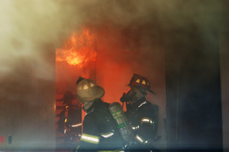
Uh-Oh- Part 1
When the cylinder pressure drops to 1000-1500 psi, your mask will start vibrating and you will hear and alarm. This means you are out of air and might have 5 minutes of air to get out of the fire.
A disadvantage is this air used to vibrate your mask and make the noise is coming from the remaining air in your SCBA. This is the time to get your partner and exit the structure.

Slide 25
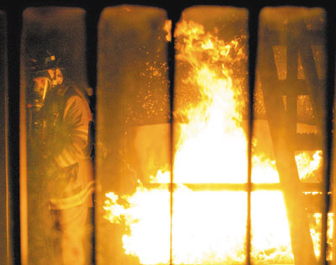
Uh-Oh- Part 2
If your regulator fails, you can use the emergency bypass valve. It will give you air while it is open. To use this, you crack open the valve long enough to get your air, then shut it off. You can also push it like a button to give yourself a puff of air. You repeat this over and over again as you leave the structure with your partner. Your equipment is no longer safe to use.
The emergency bypass valve is not to be used to cool your face or clear condensate from the mask.

Slide 26
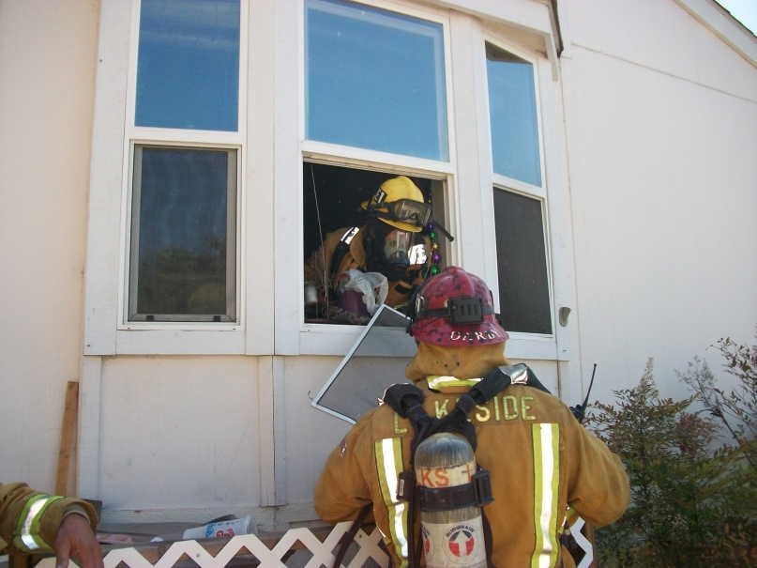
Uh-Oh- Part 3
If you run out of air, you have a several options. Although not the most favorable, these are last ditch methods to get a little bit of air and get out. The biggest thing is to slow down, stay calm and think clearly. Find a window, door, or make your own exit.
1- Connecting to your partner’s buddy breathing line. You disconnect your air line and MMR from your SCBA and connect it to the buddy breather line of your partner’s SCBA.
2-Sharing your air with your partner. Take turns with the regulator, holding your breath while your partner breathes from the regulator. You can do the same if you both have buddy breathing quick disconnect fittings.
3-Using your Nomex hood. Taking your hood off and stuffing it in the hole of your mask will filter a little bit of particulate and smoke, but it won’t provide the oxygen or cool temperatures your lungs really need.
4-Using the Universal Air Connection when the RIT Team arrives.
Last, but not least, NEVER, NEVER, NEVER, NEVER take your mask off inside of a fire.

Slide 27
SCBA Wrap-Up
The SCBA is to be used at all times when a toxic environment is, or can be present. This is to include all fires, during overhaul of scenes (looking for fire), HazMat scenes, where IC deems necessary, or any other environment where respiratory distress can occur.
Obviously SCBAs are not worn in the rehab area/cold zone of fire ground operations. You will need a chance to cool down uninhibited.
To talk while wearing a SCBA, speak at the same tone and rate you would use during a normal conversation. Screaming in your mask will not render effective communications whether face-to-face or over the radio.

Slide 28
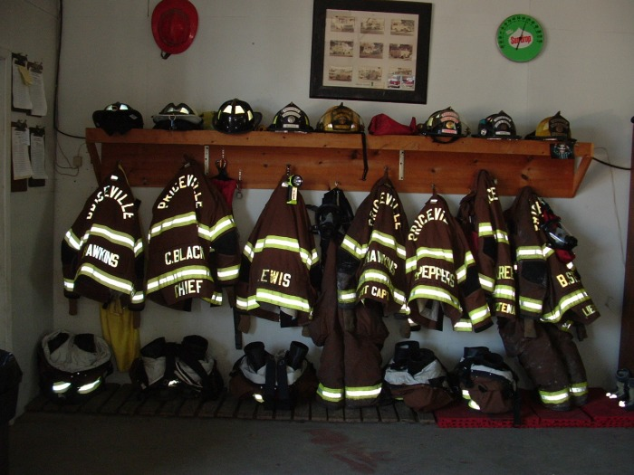
Bunker Gear

Slide 29
Bunker Gear
Bunker gear is the fire resistant protective clothing we wear to protect us from many of the elements we encounter. They do not protect us from all hazards so IC will have to determine if the gear is sufficient protection for the various scenes.
The various materials used become the 3 distinct layers which our jackets and pants contain:
1- Outer shell: Tough outer layer designed to be the protective layer
2- Moisture barrier: This layer makes the bunker gear moisture resistant
3- Insulation layer: This layer protects you from the high temperatures.
Typically the moisture barrier and the insulation layer are sewn together and designed to be removed and washed as a unit.

Slide 30
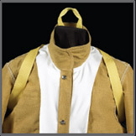
Drag Rescue Device
Your bunker gear contains a built-in harness to help drag you out of unsafe situations. The handle is located under the collar. When deployed, it tightens straps under your arms as seen in the picture.
A faster method might be to roll the firefighter onto their SCBA cylinder and drag them by the harness straps.

Slide 31
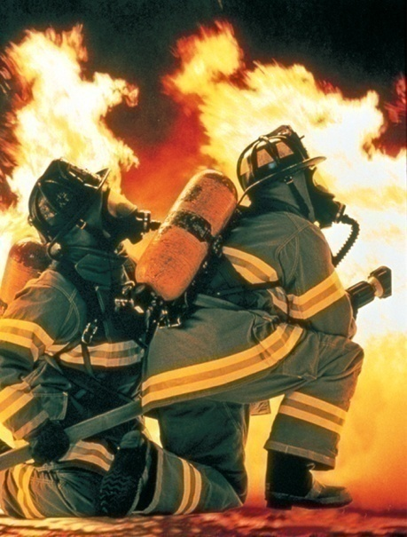
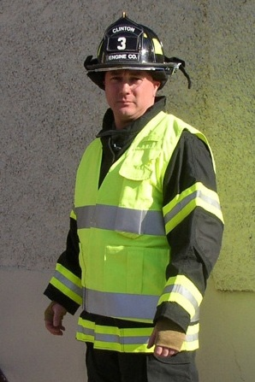
More Bunker Gear Parts
The remaining portion of your gear are the gloves, Nomex flash hood, helmet, boots, and reflective Class 3 vest.
Obviously the gloves protect your hands, the helmet protects your head, and the boots protect your feet.
The Nomex hood is to protect the areas of your head and neck left exposed by the mask and jacket. You must wear it when you are fighting a fire.
The reflective Class 3 vest is a must whenever you are working on a car accident, near any active roadway, or can somehow be put into traffic. It is a must regardless of time of day. A reflective vest is to be worn in conjunction with your bunker gear while working in such locations… regardless of temperature outside.

Slide 32
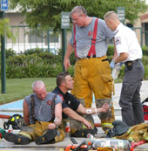
The Cold Zone
Full bunker gear (jacket, pants, gloves, and helmet) will be worn whenever you are spraying water on a scene.
You can come out of bunker gear when you are in the rehab area or when IC/Safety Officer deem it safe.
Set all of your gear on a tarp when not in use. Dirt is the enemy of the MMR and masks. Whatever you get inside of a regulator/mask someone gets to breath in the next time it gets used.

Slide 33
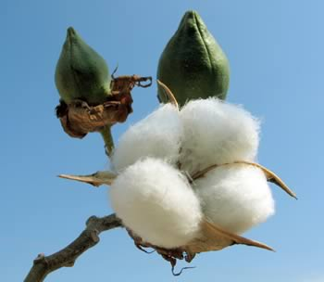
Street Clothing
Under our bunker gear it is recommended you wear something with natural cotton fibers. Otherwise, if you get into a hot place, you risk having materials like polyester, nylon, or rayon melt to your skin.

Slide 34
Accountability Tags
The last part, but not least, are the accountability tags. These tags are used to track who and when someone enters a structure fire or a large scene.
Everyone has a set of dog tags with their name, Priceville Fire Department, and some might have other personal info (like medical conditions, phone number, and blood type).
Everyone has a tag that stays on their helmet and another to give to the Accountability Officer.

Slide 35
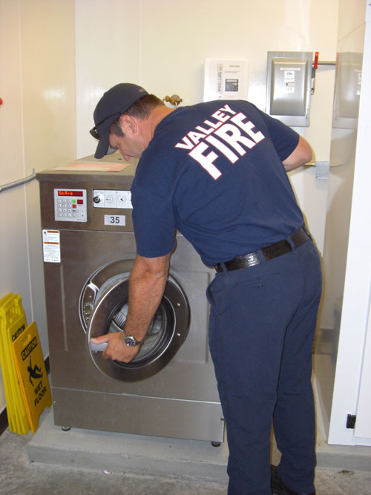
Bunker Gear Maintenance
To clean your bunker gear, you can take the liner (moisture barrier/insulating layer) out of your jacket and pants and put them into a washing machine (no agitator). Use a soap as recommended by the manufacturer. The outer shell can be washed with a brush, mild soap, and water. All items should be air dried not in direct sunlight.
To clean your mask use a cleaner as suggested by the manufacturer. We have special mask cleaning wipes to aid in the process. Make sure to wipe the rubber seal and the nose cone inside of the mask.
When not in use, all gear should be stored out of direct sunlight.

Slide 36
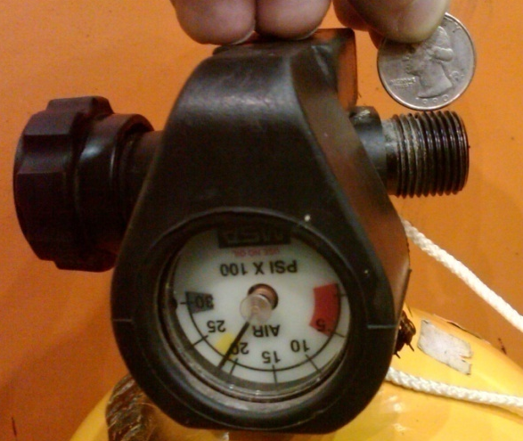
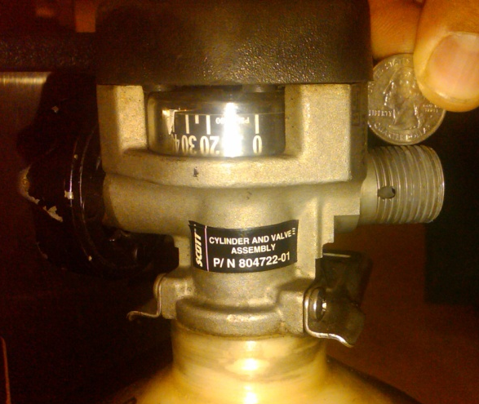
Cylinder connections… 2216 psi vs. 4500 psi- Part 1
Our current SCBA’s have 4500 psi rated cylinders. If necessary, we can connect 2216 psi cylinders- they will work. Both styles have the same physical threads.
The thread size and pitch of the 4500 psi cylinders are identical to that of a 2216 psi cylinder’s. However, 4500 psi cylinders have more threads than a 2216 psi cylinder and therefore a 4500 psi air connection can’t screw in far enough to seat completely on a 2216 psi rated cylinder. It will leave a small hole exposed in the 4500 psi cylinder’s threads. If you try to connect a 4500 psi cylinder to a 2216 psi system, air will blow through the hole because it isn’t covered by the short connector. This protects you from over-pressurizing a 2216 psi SCBA.
HOLE

Slide 37
Cylinder connections… 2216 psi vs. 4500 psi- Part 2
You can’t feed a 2216 psi system with a 4500 psi cylinder, but you can fill a 2216 psi cylinder with a 4500 psi system. Think about it, you need a higher pressure system to bring an empty cylinder up to 2216 psi. If you look at your cascade system, it has cylinders anywhere from 3000 psi to 6000 psi. and it connects to a 2216 psi cylinder. Now you become responsible for keeping an eye while filling the cylinder. Otherwise you will blow out the rupture disk if pressure gets too high in the cylinder.

Slide 38
Hydrostatic Testing
All SCBA cylinders require periodic hydrostatic testing as required by 49 CFR 180.205. The frequency of the maintenance depends upon the cylinder material.
Our cylinders require hydrostatic testing every 5 years.

Slide 39
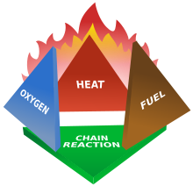
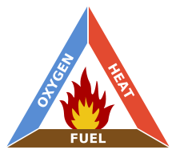
Firefighting Principles
Fire is the rapid oxidation of a material in the chemical process of combustion, releasing heat, light, and various reaction products. To extinguish a fire you need to remove one of the four components:
1- Oxygen
2- Fuel
3- Heat
4- Chemical Reaction
The fire triangle consists of the first three components: oxygen, fuel, and heat. Because chemical reaction is not something we can easily control, we usually describe the various fire phenomenon using the fire triangle.
Water is commonly used because of its thermal properties to absorb heat and it is a readily abundant material.

Slide 40
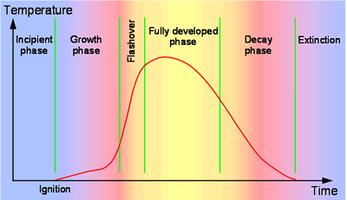
Fire Growth- Part 1
Fire has a definite life cycle. The steps in the life cycle are typically characterized by the elements of the fire triangle: oxygen, heat, and fuel.
Pyrolysis is usually the first chemical reaction that occurs in the burning of many solid organic fuels, like wood, cloth, and paper, and also of some kinds of plastic. For example, in a wood fire, the visible flames are not due to combustion of the wood itself, but rather of the gases released by its pyrolysis.
Incipient phase- phase when fire ignites: low heat, plenty of oxygen, plenty of fuel.
Growth phase- the fire is consuming more fuel and oxygen (still plenty of both), making more heat.

Slide 41
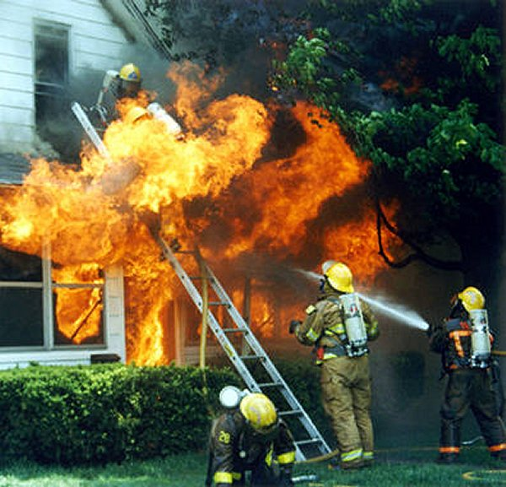
Fire Growth- Part 2: Flashover
Flashover- Is the near simultaneous ignition of all combustible material in an enclosed area.
As this phenomenon draws near you will see objects catch on fire and self-extinguish because there is not enough off-gassing to sustain the fire.
As seen in the picture, this is a dangerous situation for firefighters to find themselves in. If you do, and you cannot quickly get out, spray all the water you can at the ceiling in a fog pattern. The water will cool the environment down to hopefully less than the flashover temperatures.
To prevent a flashover from occurring you should ventilate the structure at the highest point directly over the fire… in other words, cut a hole in the roof.

Slide 42
Fire Growth- Part 3
Fully developed -or- free burning phase: there is plenty of heat, fuel is off-gassing a lot, there is a lot of oxygen.
Decay phase- typically the fire has run out of fuel and starts to cool off. However, you can have situations where it has run out of oxygen. This makes the fire a time bomb ready to explode. The next page explains this phenomenon.

Slide 43
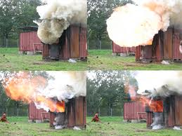
Fire Growth- Part 4: Backdraft
This is sometimes referred to as a smoke explosion. Although infrequently encountered, the fire will get to the point where there is plenty of off-gassed fuel, a lot of heat, but it is starved for oxygen. When you finally provide oxygen, by opening a door or breaking a window, the fire takes off at a violent, rapid rate (free-burning).
A backdraft is recognizable by yellow or brown smoke puffing/breathing from cracks or small openings. You will also see a heavy black soot on the inside of the windows. These are the indications of incomplete combustion of the materials.
Like a flashover, the best way to counter this is to ventilate at the highest point above the fire.

Slide 44
Fire Ground Operations- Part 1
There are a couple jobs that need to be mentioned on a fire scene. They are all important and need to be established on all structure fires.
During a fire there is one person who is ultimately responsible for how the scene runs. This person is referred to as the Incident Commander (IC). Through the incident command system they will logically determine the best way to effectively utilize the resources they have available to them. They are in charge… period!
The Safety Officer is accountable for the safety of every person on the scene. This can range from firefighters, police, EMS, bystanders, property owners, etc… The Safety Officer has the authority to shut down any scene, regardless if it causes property loss, to guarantee the safety of every single person. The lives of our team are more important than any material item on a scene.

Slide 45
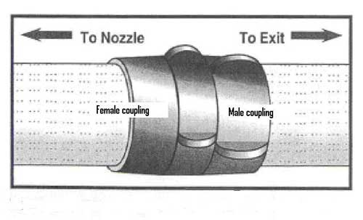
Fire Ground Operations: Part 2
If you ever get lost in a fire, or become separated from your partner, you can find your own way out by:
1- Finding a hose and following it to a truck. Smooth, bump, bump to the pump
2- Following a wall to a window. Use it to escape.
3- As you enter a structure, you will typically put the wall to one side of your body. Turn around and put the wall on the other side of your body to get out.
4- Make a mental map of how many turns and straight-aways you encounter. Use this to escape.

Slide 46
Fire Ground Operations- Part 3
If you cannot find your own way out, or become trapped by something on the scene, there are ways of getting you out:
1- Stay calm. It will help you conserve air until help can arrive.
2- Calmly, and clearly call for a Mayday using the “Who, What, Where” report. You can use these out of order, just call with all of the information below:
“Mayday, Mayday, Mayday
Who- What is your name
What- What equipment is needed
Where- Where are you located/How can you be best accessed
Mayday, Mayday, Mayday, Command Acknowledge!”
REPEAT THIS 2 TIMES
3- Activate your PASS device

Slide 47
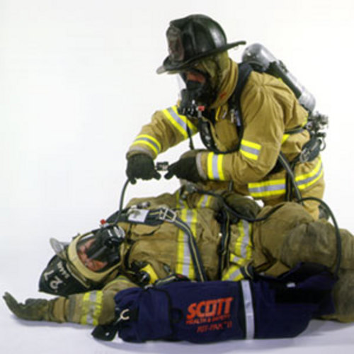
Fire Ground Operations- Part 4
A firefighter will NEVER enter a burning structure alone. You will ALWAYS have at least one partner.
For the number of personnel inside of a burning building, you will need to have that same number of people sitting outside ready to enter the fire as backup. They are referred to as the Rapid Intervention Team (RIT Team).
The RIT Team will always be fully dressed-out, ready to go (only have to mask-up/connect the MMR to the mask on your face), tools in-hand, hose ready to spray water from a backup truck.
A long blast of air horn from a fire truck, is the signal to evacuate the structure.

Slide 48
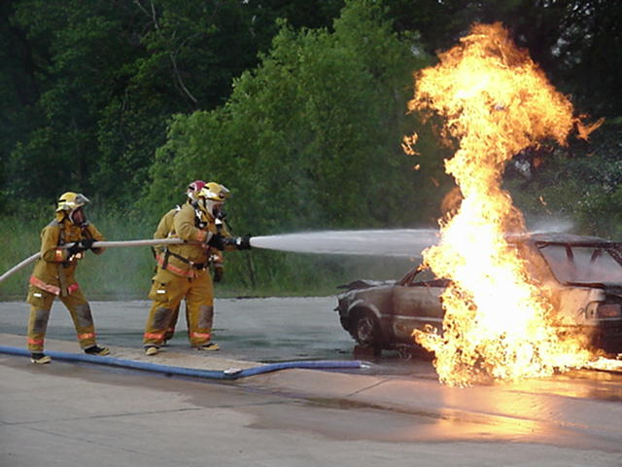
Car Fire
Car fires have their own elements of danger. The various dangers are: tires, bumpers, air bags, gas tanks, plastics, and whatever the owner could legally (or illegally) have in the trunk.
Full PPE, SCBA and Bunker Gear, will always be worn during these situations.
Approach vehicles at an angle as to not put yourself directly in front of the bumpers or tires which can explode and hit you.
http://www.youtube.com/watch?v=NPajWzThRy4

Slide 49
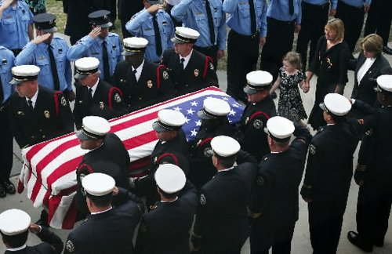
Safety
Although this is the last slide, safety should ALWAYS be first and foremost in the mind of a firefighter. We frequently respond to emergencies to help someone during their unsafe moment. The difference between us and them is we are trained and have the tools to negotiate the risks we may face. We will not make decisions that could jeopardize the safety of our team.

Slide 50
Questions
Thank you for your time!

